Slide 1
Calvert and NSoG Spatial Comparison

Slide 2
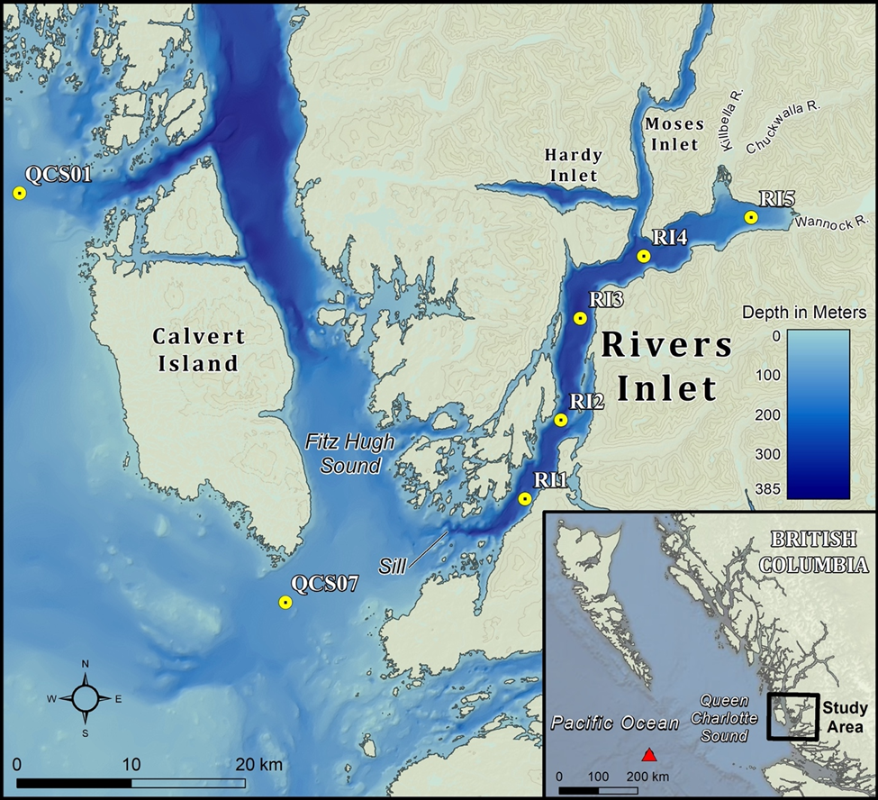
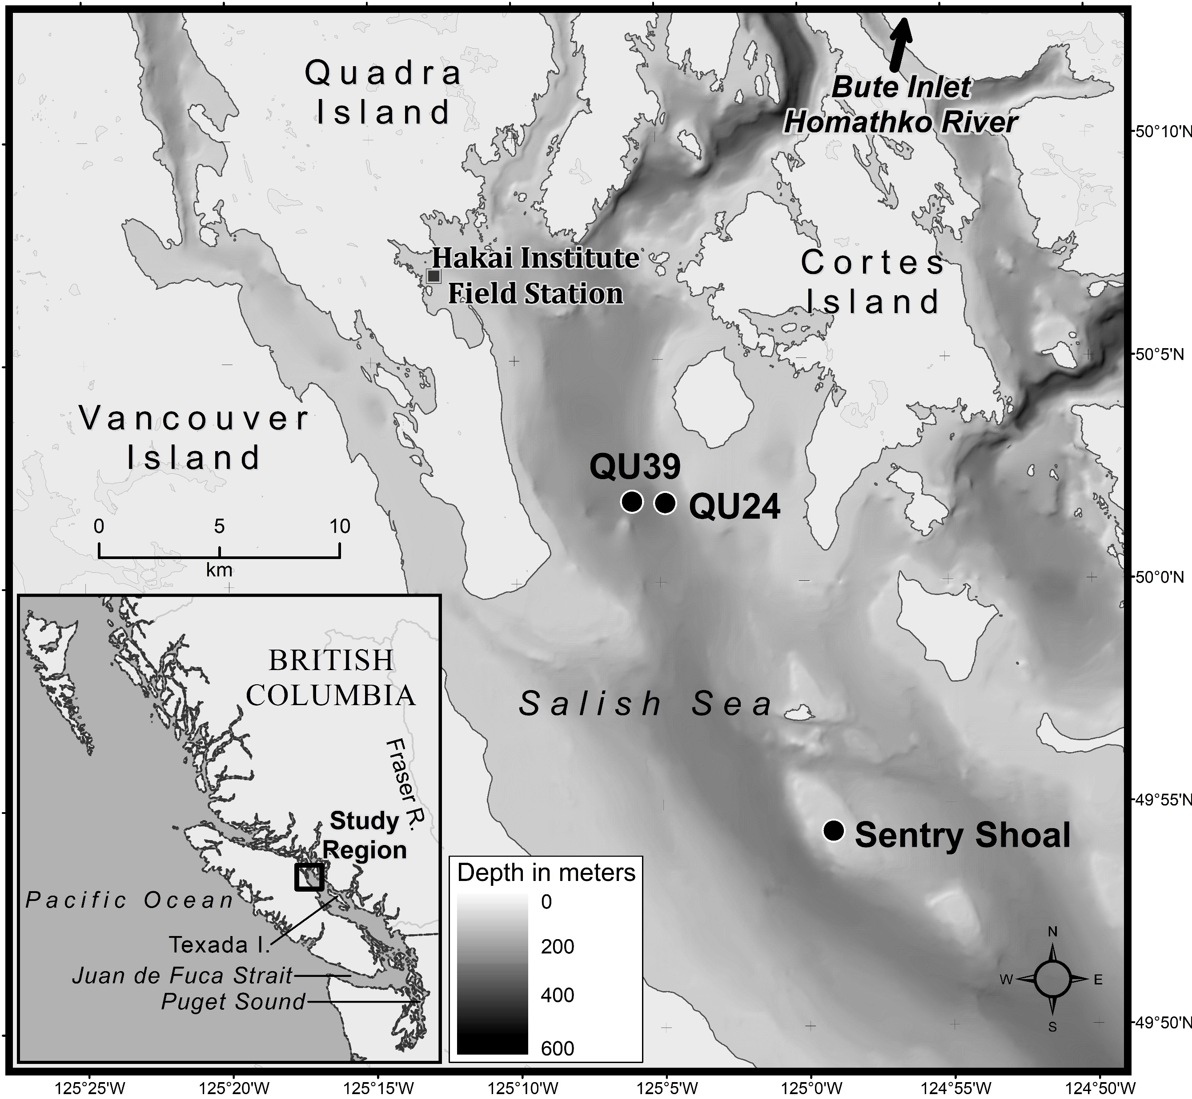
Station Locations
Sorry, these are rough, but give an idea.
Shelf (S)
Channel (C)
KC10
DFO2
Fjord (F)
Estuary (E)

Slide 3
Methods to note
Only photosynthetic species retained
Dinoflagellates removed (suggested by Louis):
Gymnodinium
Gyrodinium
Katodinium
Unknown species/cells removed.
Monthly sampling - May to October 2018 – 2020, only months with high enough data availability/continuity
2018 QU39 from 0m, everything else 5m (will make case that pigments are comparable?)
QU39 (weekly) downscaled to meet Calvert (monthly) by selecting closest date to Calvert survey. I think a monthly average would skew results. Always a QU39 day within a few days of Calvert surveys
Some Calvert surveys started at end of month and extended into next (i.e. one station sampled on August 31st for the “September” survey). For plots with data separated out by month, I pushed this station into the next month to avoid having two data points in the same month.
Chemtax data only available for 2019 and 2020.

Slide 4
Key points
QU39 (NSoG) different
Diatoms nearly non-existent
Much warmer during the summer
Despite different physical/chemical drivers and oceanography settings - Calvert stations seem relatively comparable with some exceptions
DFO2 seems to show fewer diatom species – QCS01/KC10 more species
QCS01 sometimes shows higher summer species diversity, richness and greater influences by haptophytes not seen in microscopy (if we include chemtax data)

Slide 5
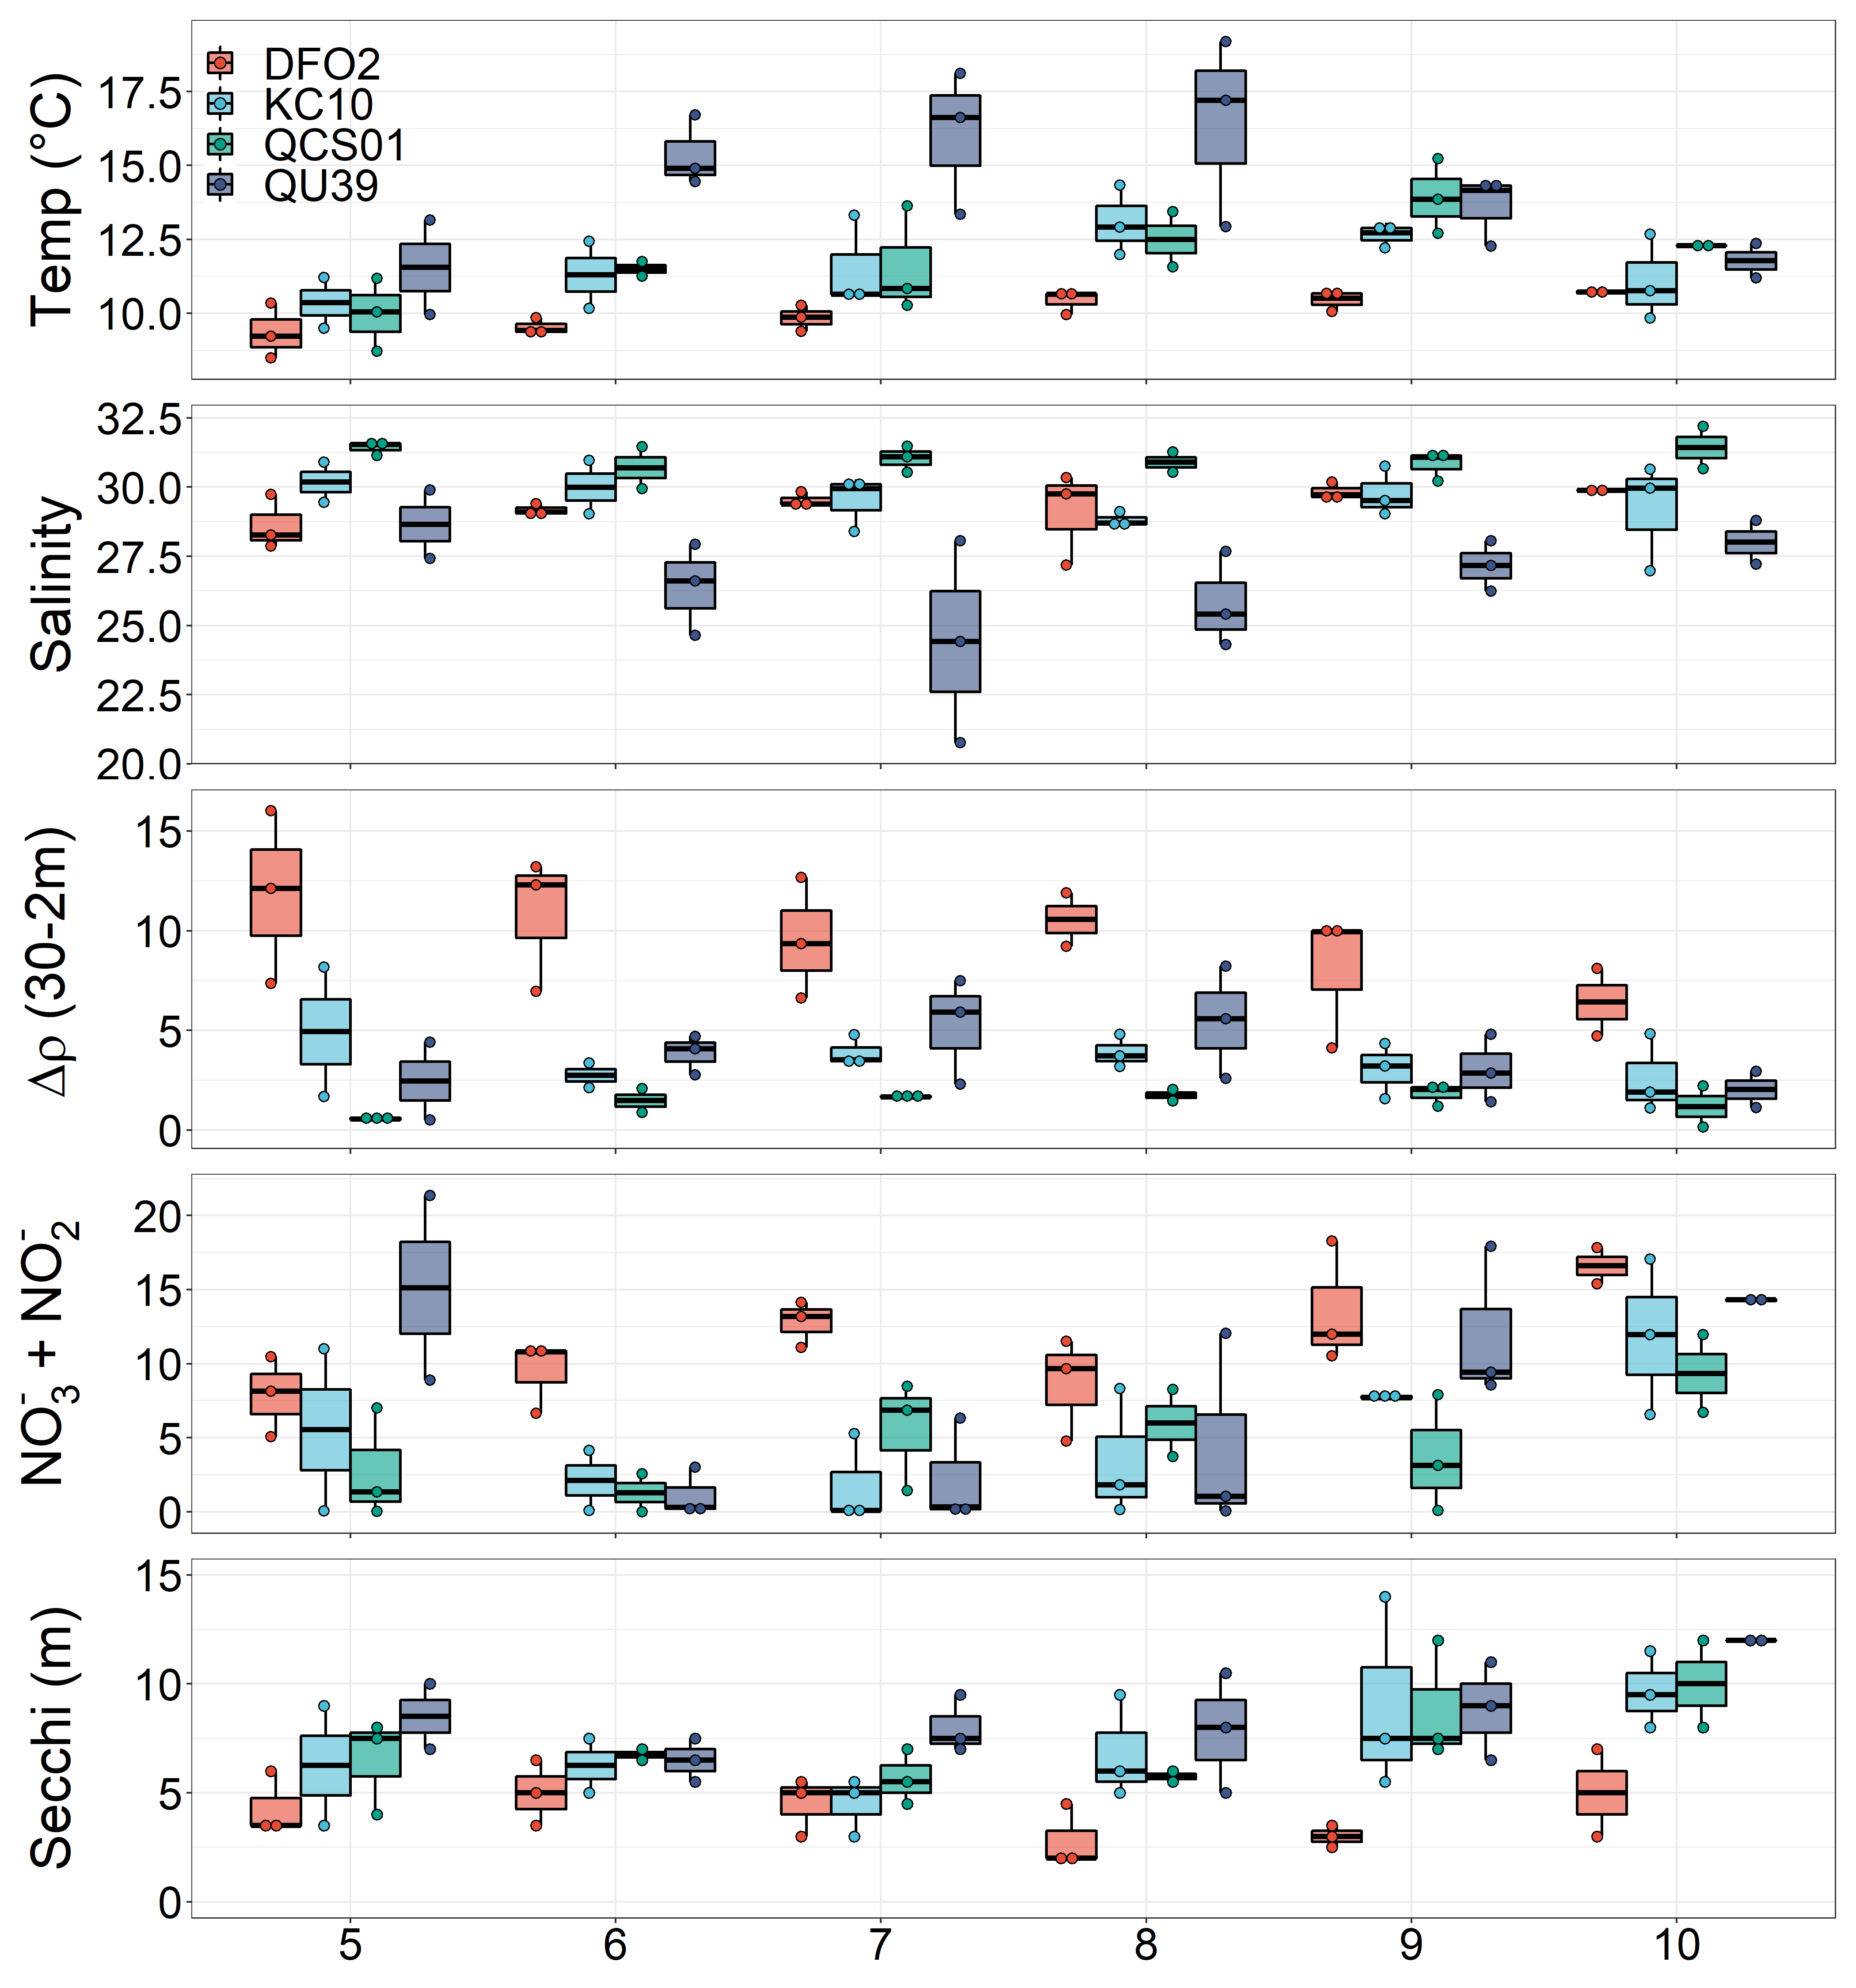
Physical-Chemical (5m)
QU39 is much warmer from June through August
Would be statistically warmer, but need test (AVOVA?)
DFO2 is the coolest station. QCS01/KC10 similar
QU39 freshest June through September
Only because 5m misses surface layer at DFO2
Maybe I should be using a 0 – 5m average?
QCS01 most saline
DFO2 is most stratified – measurement captures surface layer
QU39 and KC10 similar
QCS01 least stratified
A bit all over the place – variability is plankton vs monthly sampling
DFO2 has much higher nutrients (including PO4 and SiO2)
DFO2 has shallowest secchi depths August through September – freshest/runoff

Slide 6
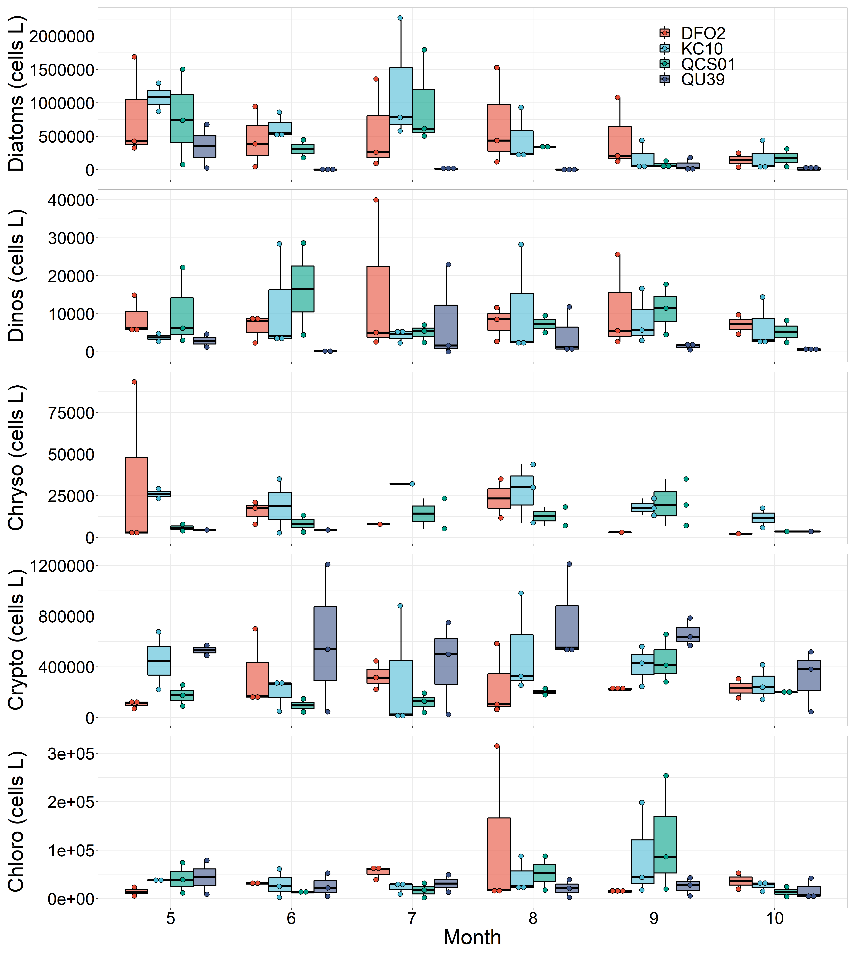
Group Level Abundance
Key point 1) NSoG is diatom poor from June through August. The dominant physical difference when compared to the central coast is greater temperature, notably from June through August.
Tough to discern trends in other groups due to variability

Slide 7
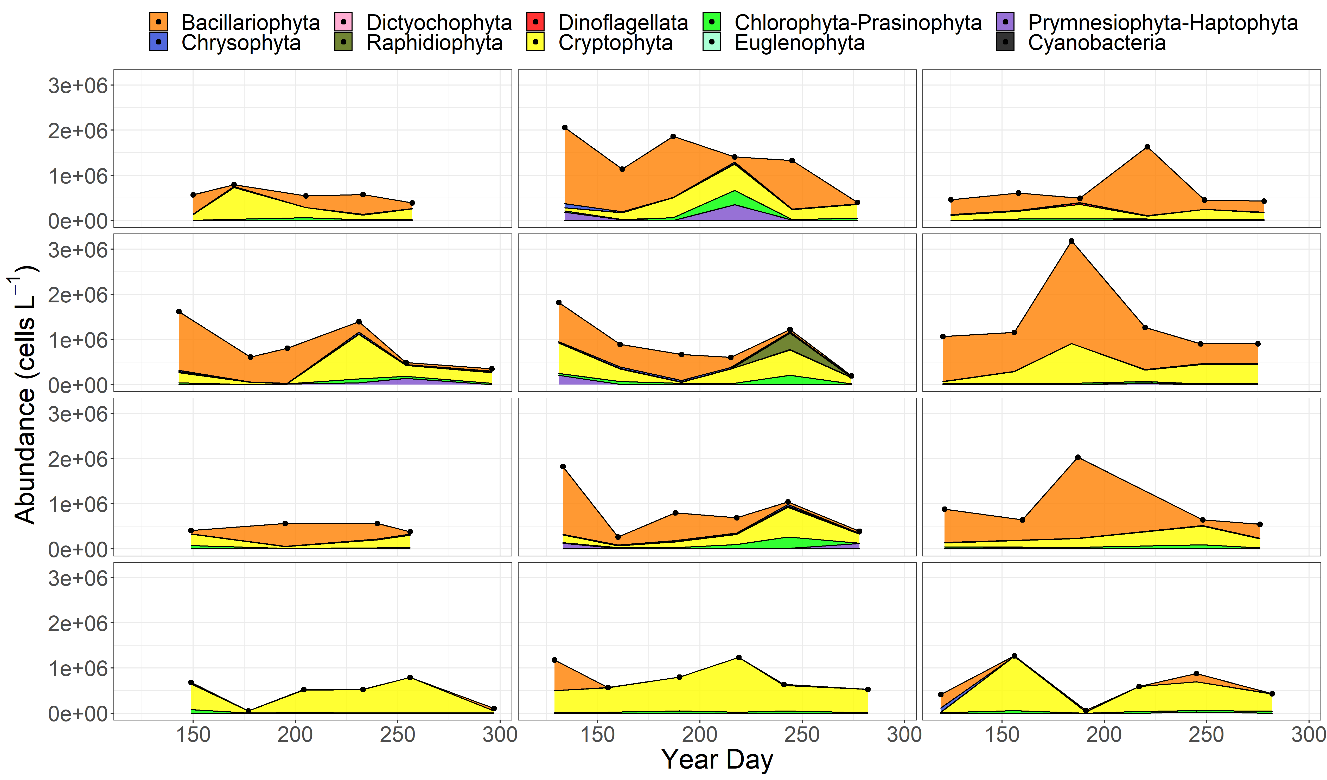
Microscopy Abundance Timeseries – Alternative version next slide
DFO2 (F)
2018
2019
2020
QU39 lacks diatoms
KC10 and QCS01 look relatively similar, but DFO2 has some differences.
Quite a bit of interannual variability
KC10 (C)
QCS01 (S)
QU39 (E)

Slide 8
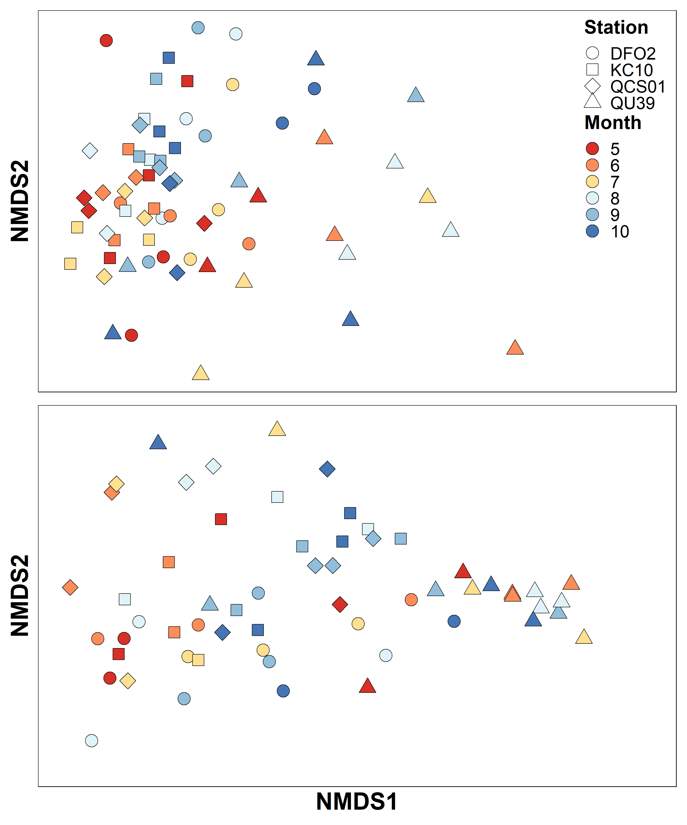
Microscopy Abundance – nMDS
Bray Curtis similarity
Closer points are more similar
QU39 is different during the summer (lack of diatoms)
QU39 June and rest of stations more similar (diatoms)
Seems to be a rough spring-autumn gradient (excluding QU39)
Log¹⁰(Abundance)
sqrt(Relative Abundance)

Slide 9
Statistical tests added to nMDS analysis
ANOSIM -
Testing differences in Bray-Curtis community matrix data between:
Region (Calvert vs NSoG) p = 0.0001, R = 0.62
Site (QCS01, KC10, DFO2, QU39) p = 0.0001, R = 0.27
1) Indicator species - between region
Calvert – only where P <= 0.01
Chaetoceros tenuissimus 0.720 0.0001 ***
Skeletonema marinoi 0.684 0.0001 ***
Leptocylindrus danicus 0.661 0.0001 ***
Dinophyceae 0.623 0.0001 ***
Euglenozoa 0.604 0.0001 ***
Thalassiosira 0.588 0.0001 ***
Cylindrotheca closterium 0.563 0.0001 ***
Ceratium lineatum 0.494 0.0007 ***
Thalassionema nitzschioides 0.484 0.0005 ***
Chaetoceros cinctus 0.483 0.0004 ***
Pennales 0.477 0.0001 ***
Biddulphiales 0.471 0.0007 ***
Dinophysis acuminata 0.462 0.0010 ***
Pseudo-nitzschia seriata 0.461 0.0006 ***
Chaetoceros debilis 0.460 0.0009 ***
Pseudo-nitzschia spp. 0.448 0.0005 ***
QU39
Corethron criophilum 0.364 0.0024 **
Central coast indicators are mostly diatoms, which are largely absent at QU39 in the summer. This seems to drive the dissimilarity in cluster analysis and nMDS.

Slide 10
Statistical tests added to nMDS analysis
2) Indicator species - between Calvert Stations
Group DFO2 #sps. 1
stat p.value
Dinophysis acuta 0.376 0.0189 *
Group KC10 #sps. 1
stat p.value
Biddulphiales 0.335 0.0471 *
Group QCS01 #sps. 6
stat p.value
Chaetoceros decipiens 0.455 0.0049 **
Dactyliosolen phuketensis 0.429 0.0072 **
Detonula pumila 0.422 0.0058 **
Thalassiosira rotula 0.412 0.0101 *
Ditylum brightwellii 0.390 0.0130 *
Prorocentrum micans 0.380 0.0200 *
Group KC10+QCS01 #sps. 12
stat p.value
Ceratium lineatum 0.581 0.0003 ***
Dactyliosolen fragilissimus 0.513 0.0006 ***
Chaetoceros debilis 0.490 0.0012 **
Guinardia delicatula 0.448 0.0037 **
Rhizosolenia setigera 0.415 0.0082 **
Chaetoceros seiracanthus 0.411 0.0098 **
Pseudo-nitzschia seriata 0.401 0.0097 **
Protoperidinium steinii 0.399 0.0164 *
Chaetoceros similis 0.381 0.0195 *
Pseudo-nitzschia 0.368 0.0227 *
Pterosperma 0.351 0.0336 *
Leptocylindrus danicus 0.349 0.0403 *
Suggests differences in ecology across the Shelf to fjord gradient – DFO2 is the most different as KC10 and QCS01 share species. Seems like increased diatom richness and diversity at QCS01 and KC10.

Slide 11
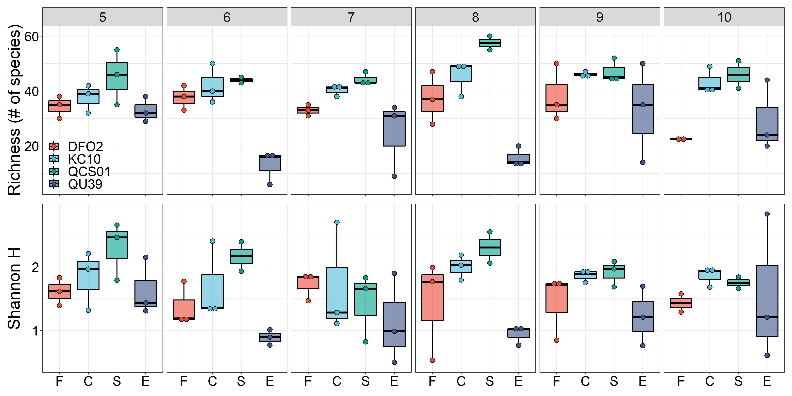
Diversity
QU39 typically has the lowest richness and diversity, notably from June through August, with increases in the fall representative of increases in diatoms
Calvert – DFO2 tends to have lowest richness and diversity (2019 likely exception)
QCS01 in August has high richness.
Least frequent data removed – need to fix and update.

Slide 12
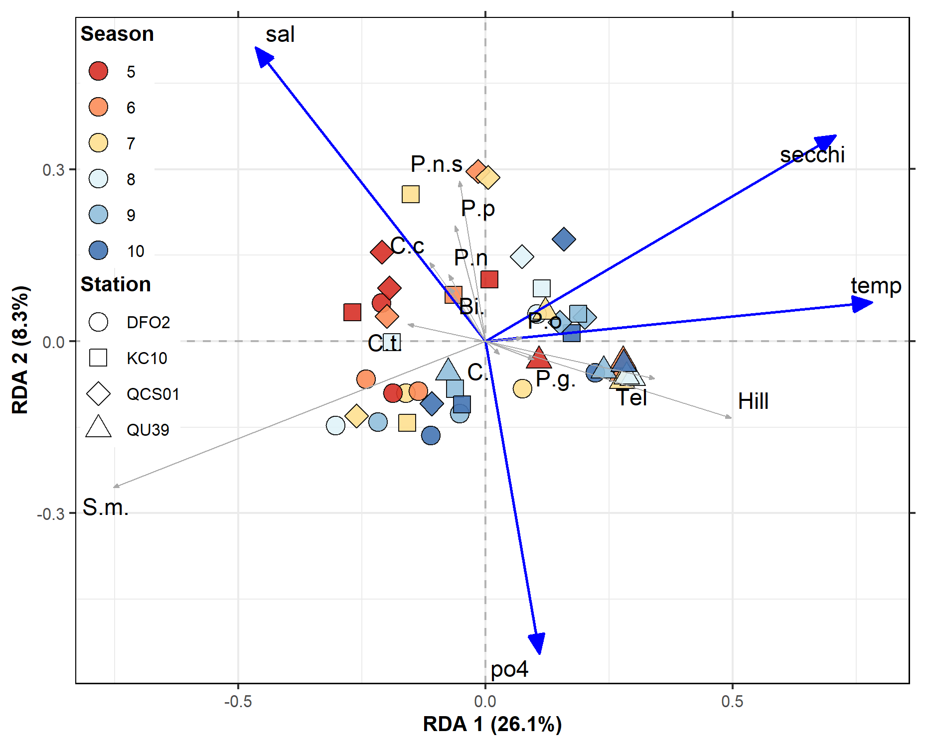
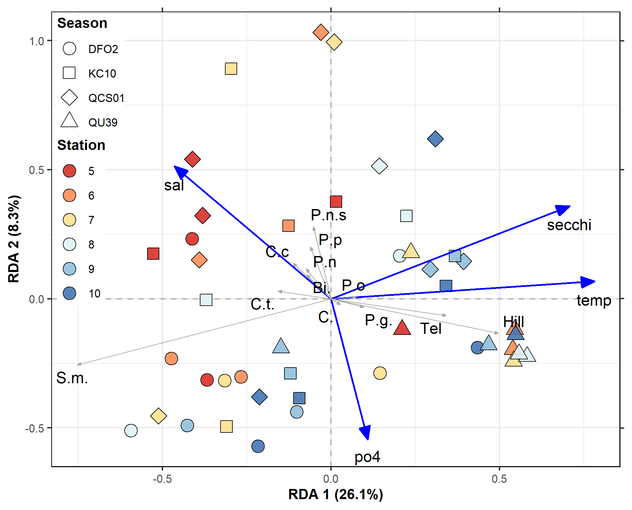
Multivariate Statistics – RDA used to investigate correlations with environmental drivers, data interpretation on next plot.
Scaling 1
Scaling 2
Species with top 10 highest abundance & site scores plotted
Eigenvectors are scaled to unit length
Distances among objects - Euclidean distances
Projecting an object at right angle on a response variable or a quantitative explanatory variable approximates the position of the object along that variable.
The angles among response vectors are meaningless
Angles between response and explanatory variables in the biplot reflect their correlations
Relationship between the centroid and a response variable (species) is found by projecting the centroid at right angle on the variable (as for individual objects).
Eigenvectors are scaled to the square root of their eigenvalue.
Distances - not approximations of their Euclidean distances
Projecting an object at right angle on a response or an explanatory variable approximates the value of the object along that variable
Angles in the biplot between response and explanatory variables, and between response variables themselves or explanatory variables themselves, reflect their correlations.
Angles between descriptors in the biplot reflect their covariances or correlations.
Relationship between the centroid of a qualitative explanatory variable and a response variable (species) is found by projecting the centroid at right angle on the variable (as for individual objects).

Slide 13
Multivariate Statistics – RDA
Scaling 1
Scaling 2
Axis 1 (RDA 1), which contains the majority of the explained variance (27.8%), is driven by temperature
There is a rough spring to late summer gradient/autumn gradient along this axis (late summer is warmer)
A cluster is comprised of QU39 and two DFO2 stations, and these are related to Telelaux and Hillea (cryptophytes) and temperature
Skeletonema marinoi (S.m.) is inversely related to temperature and a grouping of Calvert spring/summer (bloom) samples (includes DFO2)
Axis 2 (RDA 1) – driven by salinity/PO4, but much less explained variability (5.5%)
Group of primarily QCS01 and KC10 summer samples related to non-S.m. diatoms (i.e. Chaetoceros spp (C.S., C.C.), pseudo nitzschia (P.n.s), increased salinity and reduced po4 (DFO2 is different in summer with less diatoms diversity? – also suggested by indicator species analysis and diversity/richness).

Slide 14
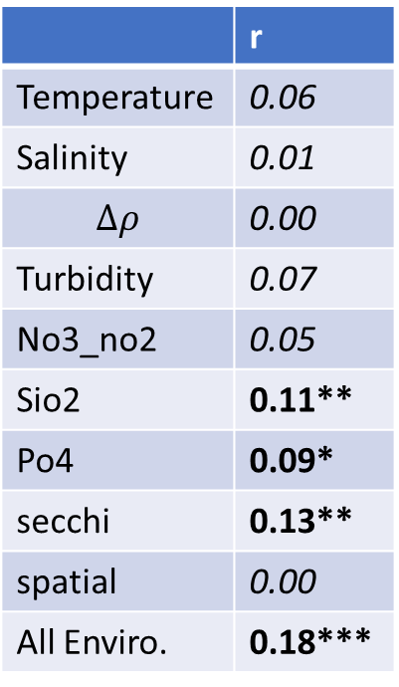
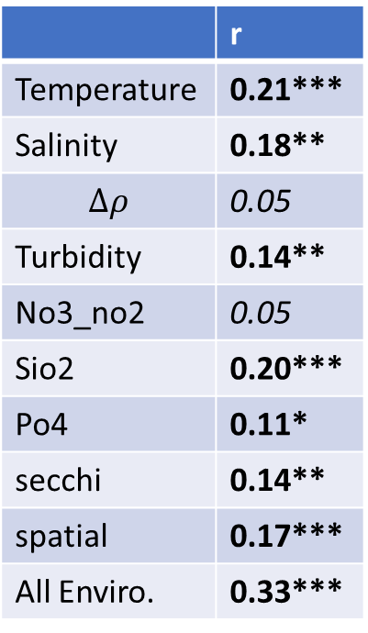
Mantel Tests
Test – Does species Bray Curtis dissimilarity matrix vary with Euclidean distance of drivers?
All enviro includes everything, excluding spatial information, and different included data are centered/standardized.
Calvert + QU39
Similar to RDA results – temp + spatial
Bray-Curtis dissimilarity becomes more dissimilar with spatial distance – shows regional difference
Calvert Alone
Spatial differences insignificant.
Differences driven by environmental drivers:
Sio2
Po4
Secchi
All enviro.
Calvert + QU39
Calvert Only
 | r
Temperature | 0.21***
Salinity | 0.18**
$$∆ρ$$ | 0.05
Turbidity | 0.14**
No3_no2 | 0.05
Sio2 | 0.20***
Po4 | 0.11*
secchi | 0.14**
spatial | 0.17***
All Enviro. | 0.33***
 | r
Temperature | 0.06
Salinity | 0.01
$$∆ρ$$ | 0.00
Turbidity | 0.07
No3_no2 | 0.05
Sio2 | 0.11**
Po4 | 0.09*
secchi | 0.13**
spatial | 0.00
All Enviro. | 0.18***

Slide 15
Chemtax – Do we include?

Slide 16
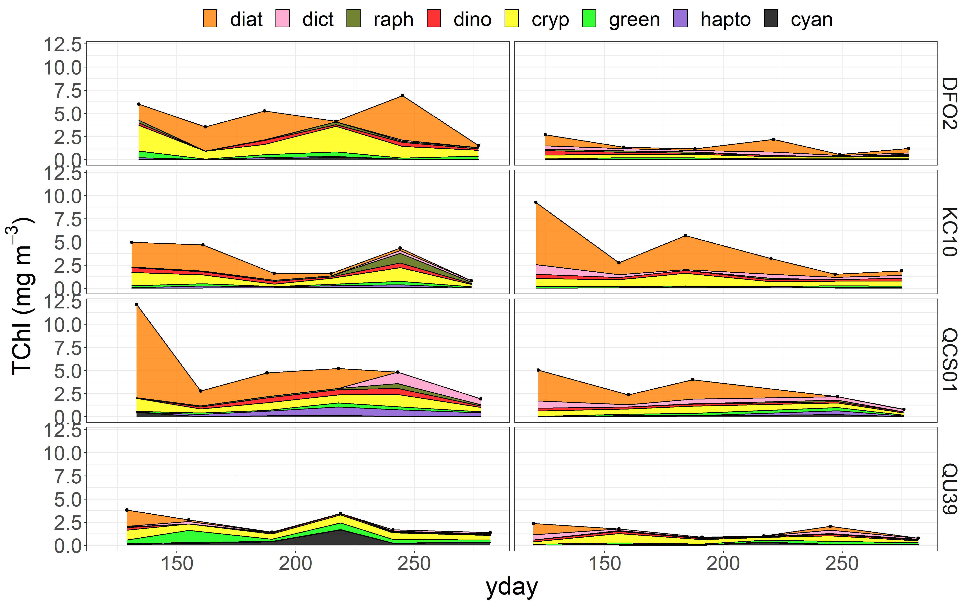
Chemtax timeseries (only 2019-2020)
Quite a but of annual variability
Again, lack of diatoms at QU39, bit 2019 had high flagellate biomass
Differences at DFO2 between years, much higher biomass in 2019. Why? Less vertical advection from outflow? Cryptos have comparatively higher biomass – this trend not reflected in micro
Interested in August/September haptophytes at QCS01 – not seen by microscopy. Offshore?
2019
2020

Slide 17
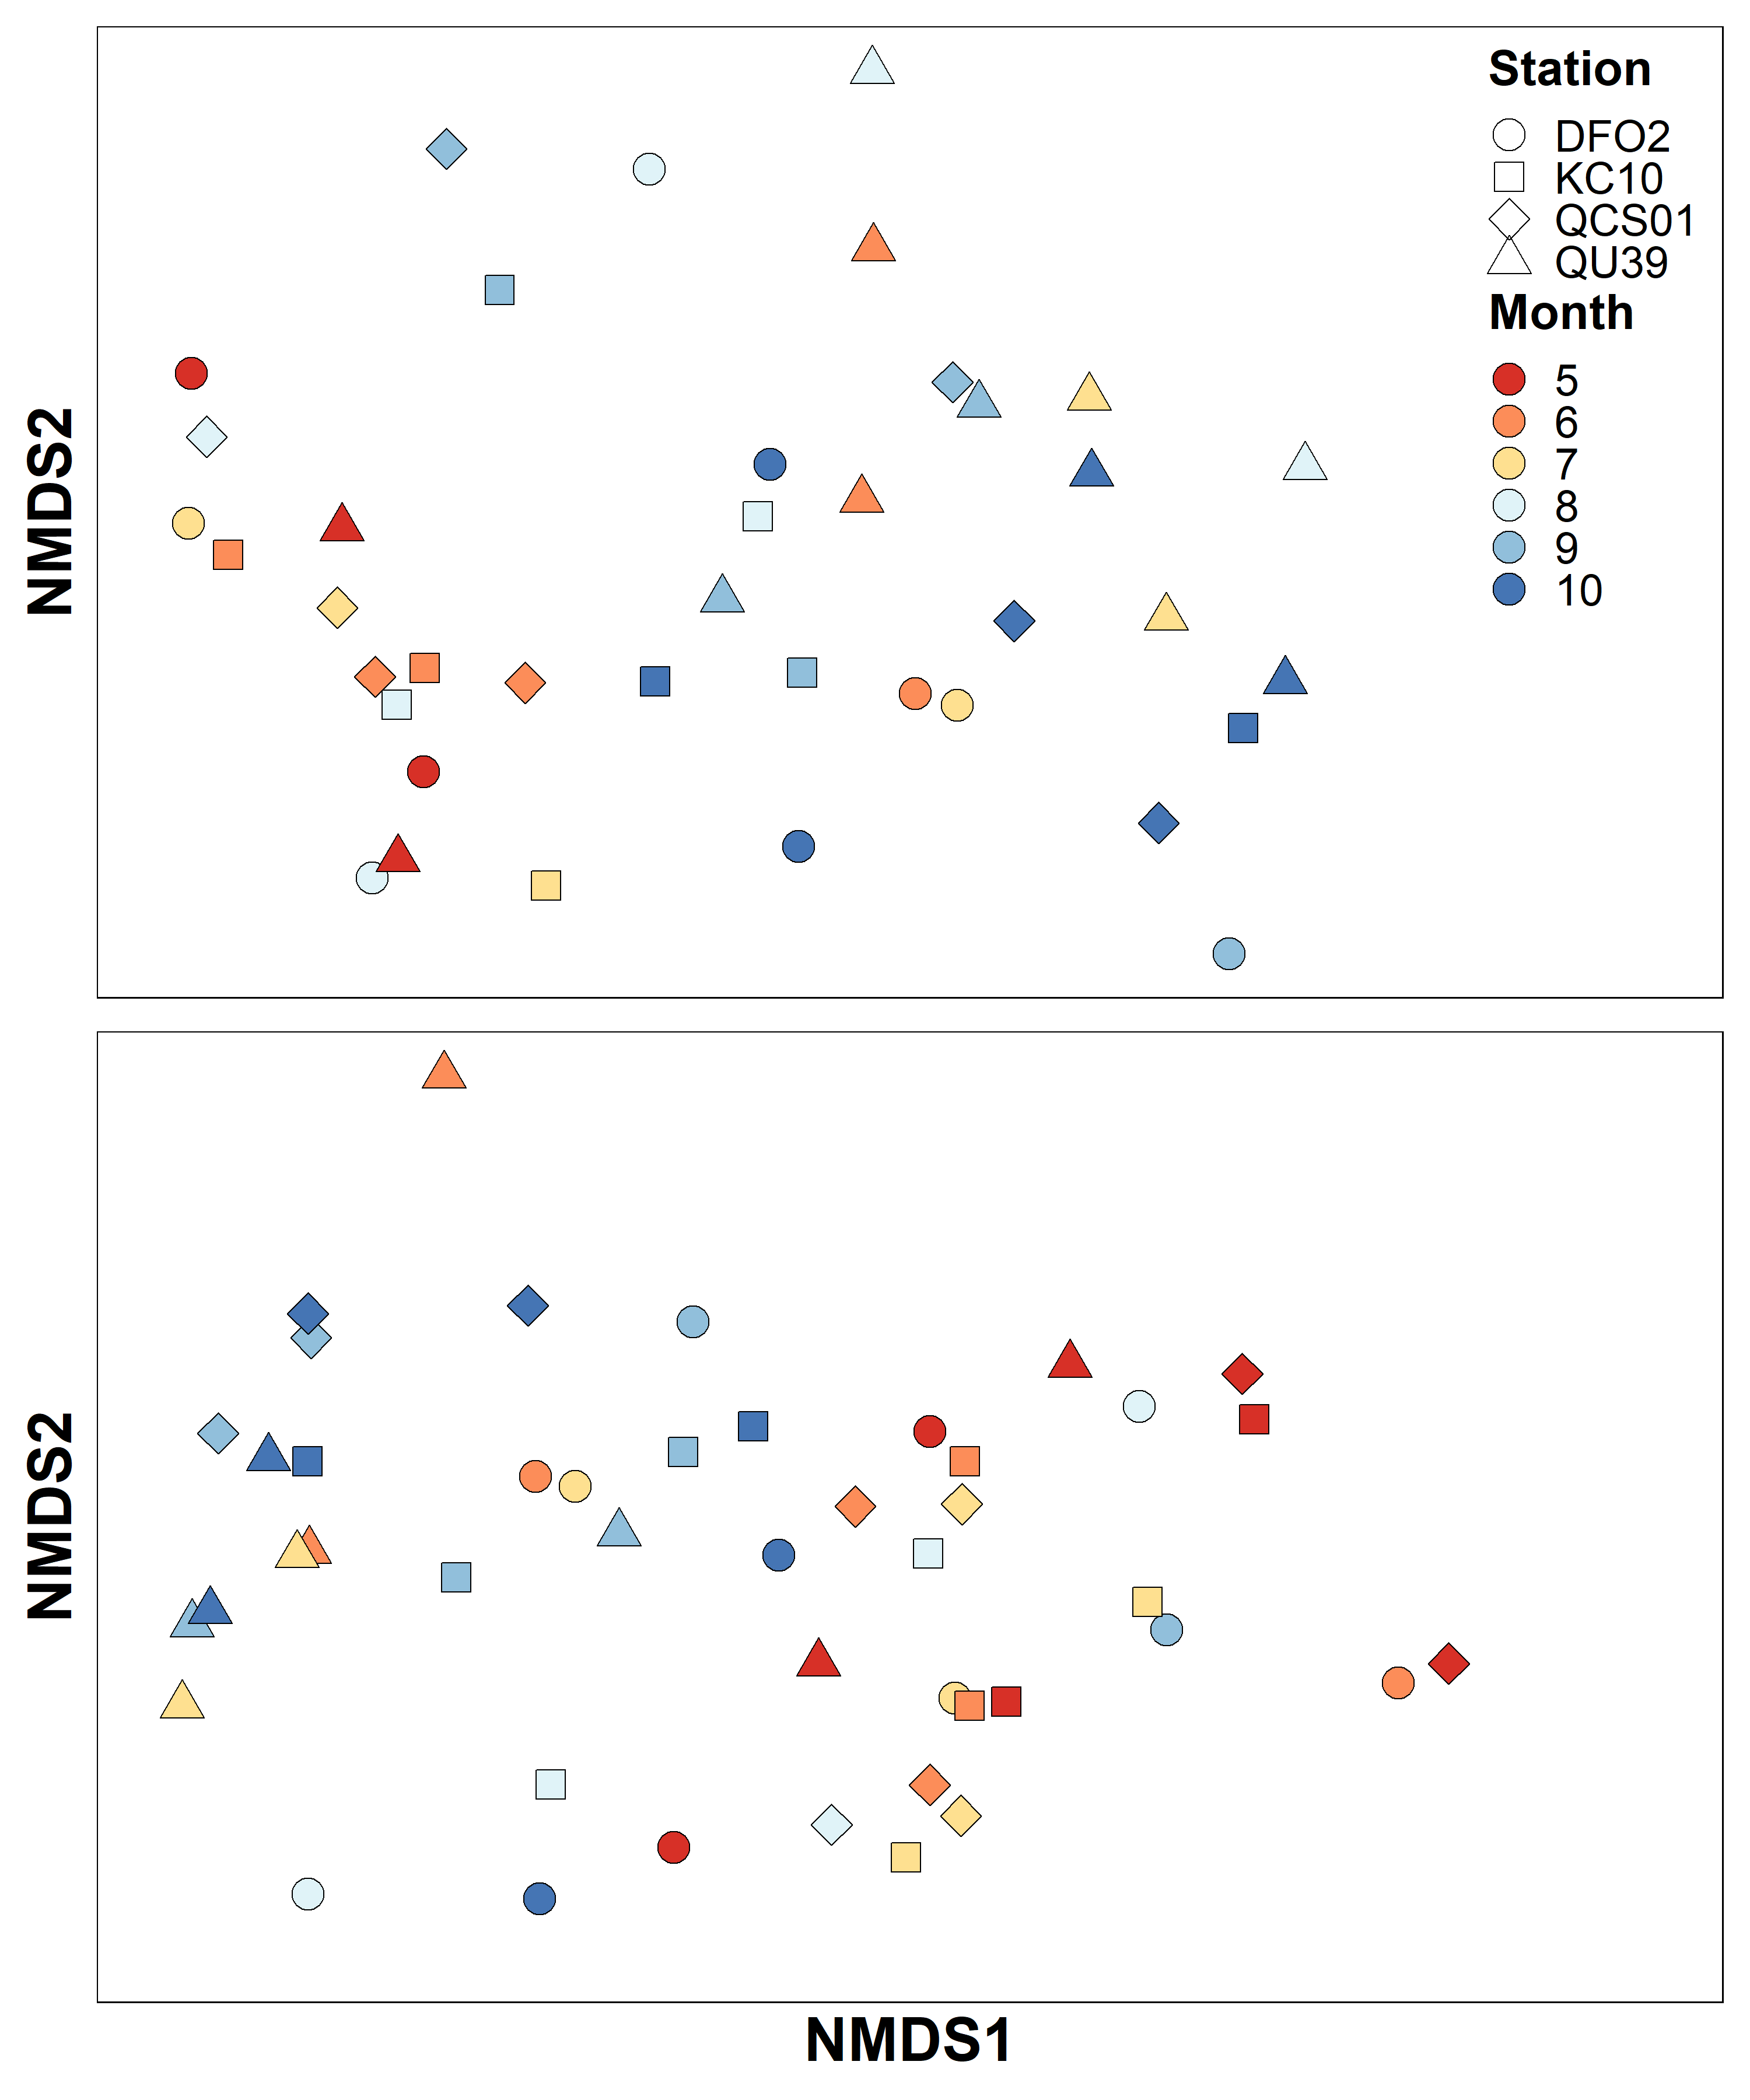
Chemtax nMDS
Unlike taxonomy, little difference between QU39 and Calvert stations – fewer things to separate on (i.e. species versus pigment groups) but also, greater importance and similarity in small species biomass not seen by microscopy
Seems to be more of a seasonal gradient (generally) and I suspect bloom versus non-bloom.

Slide 18
Statistical tests added to nMDS analysis - Chemtax
ANOSIM
Differences in Bray-Curtis community matrix between:
Region (Calvert vs NSoG) p = 0.0017, R = 0.22
Site (QCS01, KC10, DFO2, QU39) p = 0.0063, R = 0.13
Month p = 0.0112, R = 0.13
1) Indicator species - between region
Calvert stat p.value
diat 0.492 0.0024 **
dino 0.483 0.0022 **
NSoG
cyan 0.355 0.0058 **
green 0.341 0.0347 *
Differences not as great as with microscopy
2) Indicator species - between Calvert Stations
Group QCS01 #sps. 1 stat p.value
hapto 0.516 0.0047 **

Slide 19
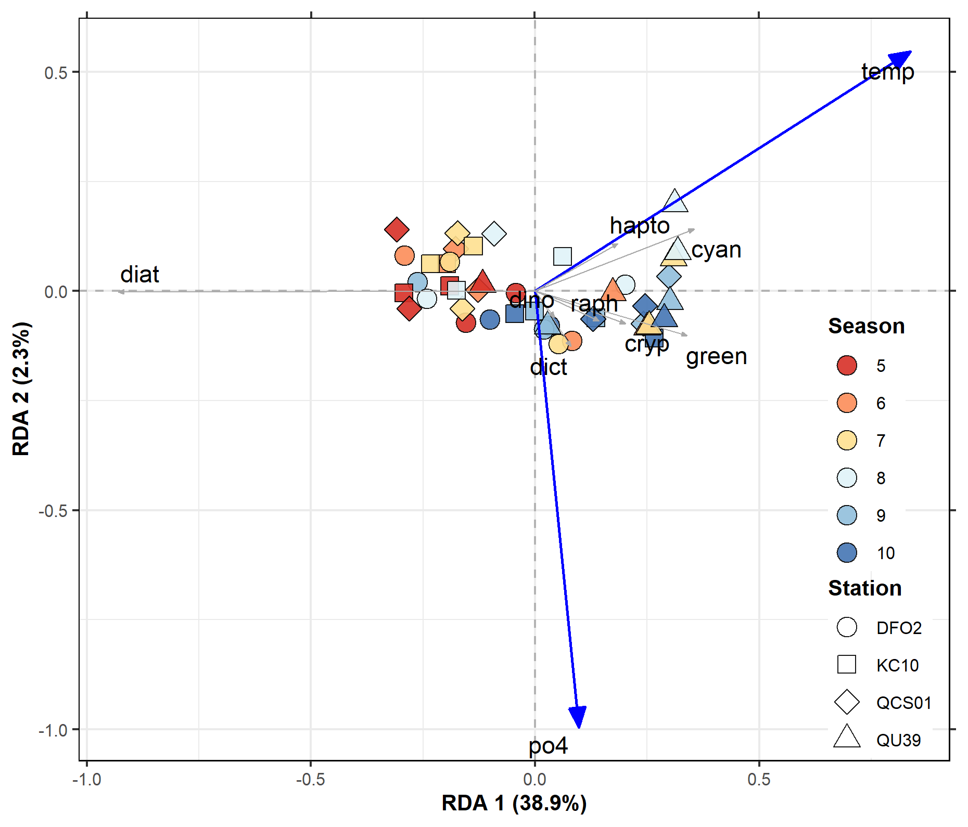
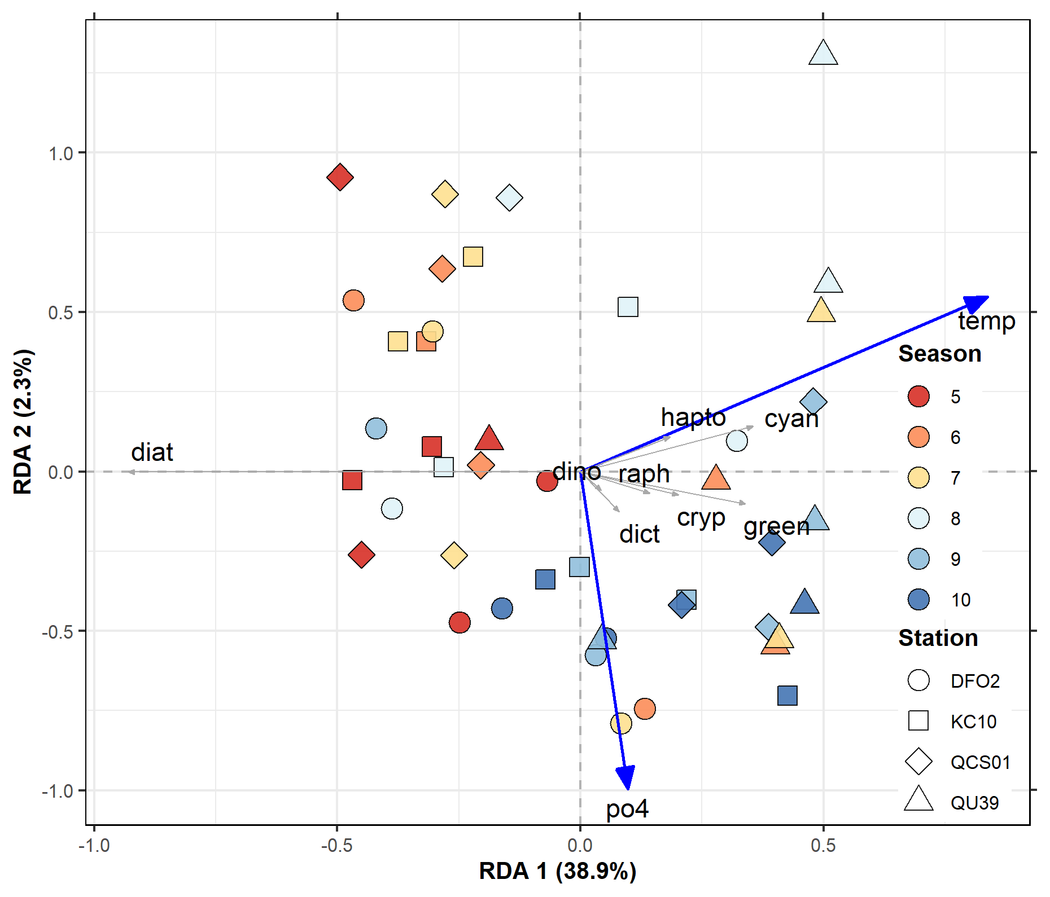
Chemtax RDA
Second axis is not significant. Most of the constrained variance is explained by the first axis and appears to be driven largely by season and phytoplankton group with diatom biomass inversely correlated to the flagellate groups. Haptophytes and cyanobacteria are driven by temperature. Is this usable with a non-significant axis?

Slide 20
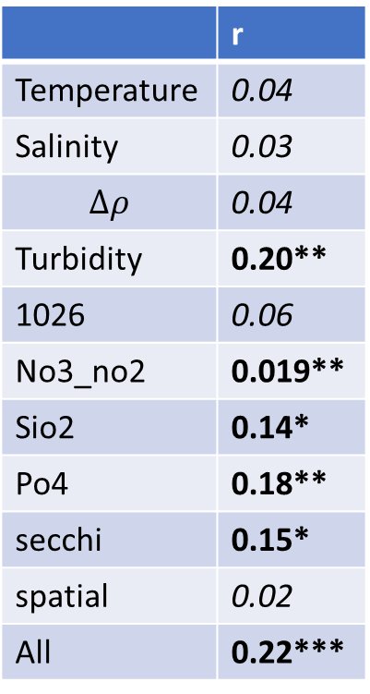
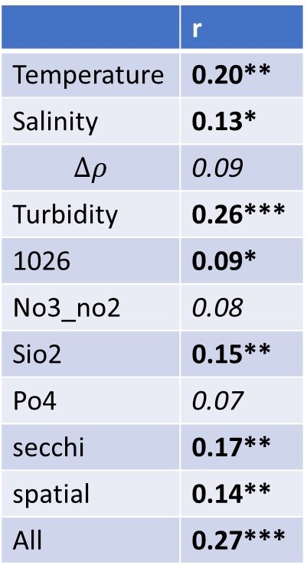
Chemtax Mantel
This suggest:
Temperature and salinity differences largely due to regional differences?
At Calvert – differences in phytoplankton groups are not related to spatial differences, but environmental drivers.
Turbidity
NO3 + NO2
SiO2
PO4
Secchi
All environmental factors combined
Calvert + QU39
Calvert Only
 | r
Temperature | 0.20**
Salinity | 0.13*
$$∆ρ$$ | 0.09
Turbidity | 0.26***
1026 | 0.09*
No3_no2 | 0.08
Sio2 | 0.15**
Po4 | 0.07
secchi | 0.17**
spatial | 0.14**
All | 0.27***
 | r
Temperature | 0.04
Salinity | 0.03
$$∆ρ$$ | 0.04
Turbidity | 0.20**
1026 | 0.06
No3_no2 | 0.019**
Sio2 | 0.14*
Po4 | 0.18**
secchi | 0.15*
spatial | 0.02
All | 0.22***

Slide 21
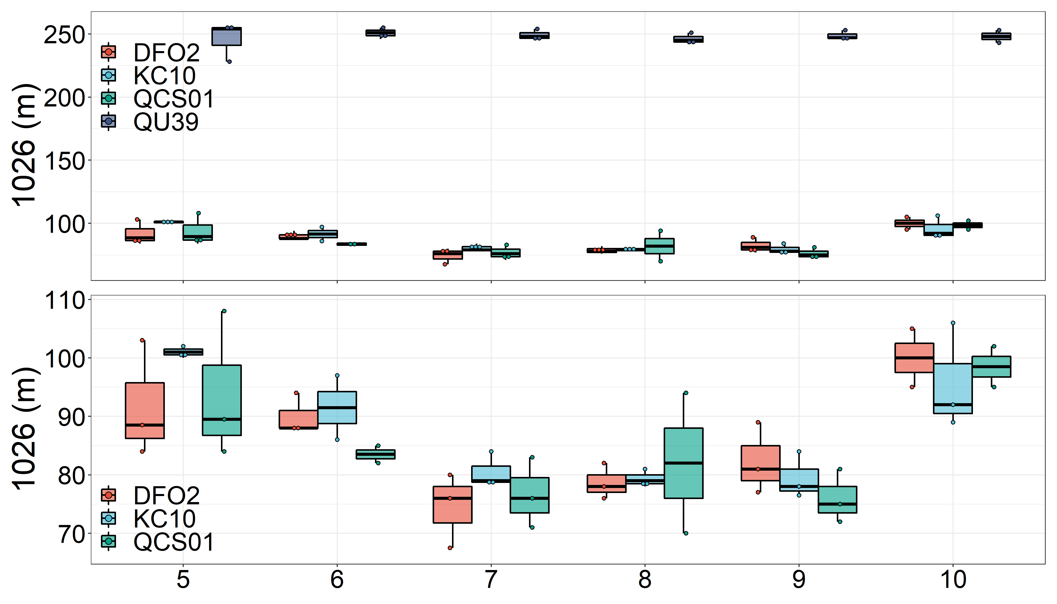
Calvert Variability – QCS01 offshore influence
Wanted to look into Chemtax haptophytes in August/September 2019 at QCS01 (shelf station).
Interested in upwelling, so tried looking at 1026 depth.
A bit out of my expertise, but do these depths seem reasonable. If so, QCS01 showed high variability between 2018 and 2019 (no 2020 measurement). 2020 was the year with the chemtax haptophyte influence. Does this line up in any way – next slide.

Slide 22
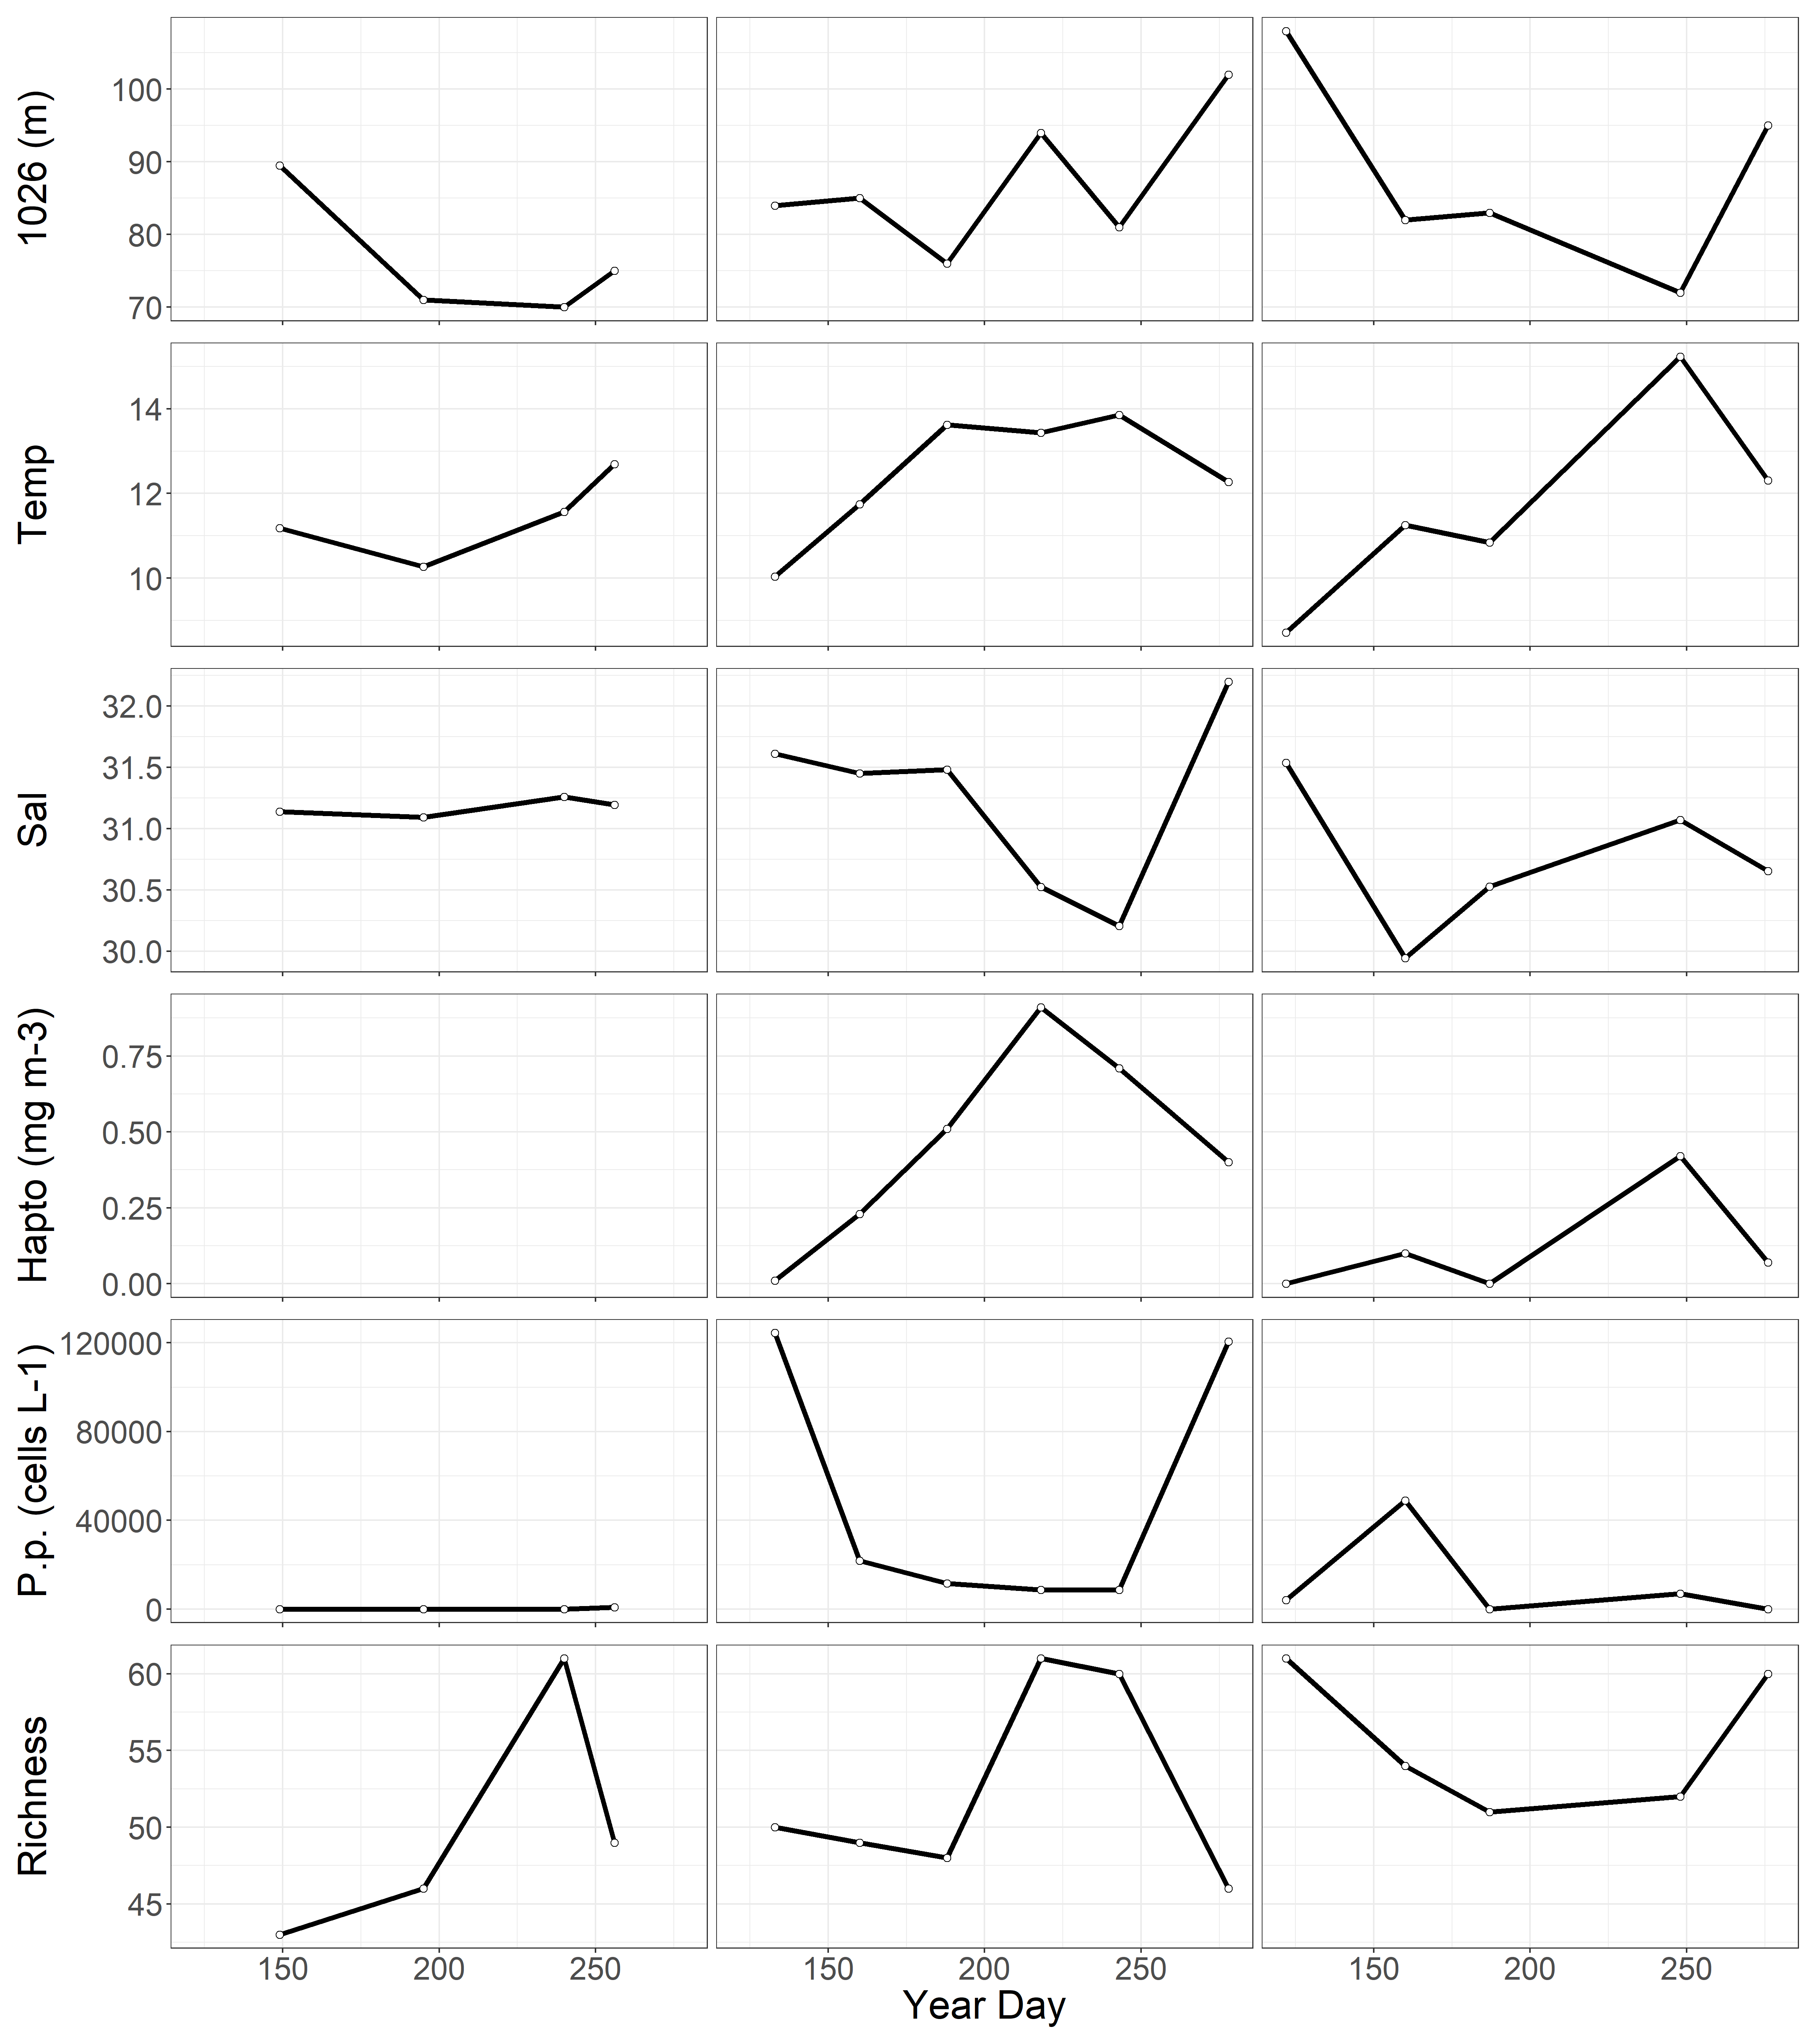
QCS01 - 2018
QCS01 - 2019
QCS01 - 2020
I wanted to see if the 2019 Chemtax haptophyte biomass (not seen in microscopy) and increased species richness, had anything to do with an offshore influence
1026 was generally deeper in 2019 (less upwelling?)
Salinity was low (maybe a coastal influence?)
But, opposite effect seen in 2020 (i.e. shallower 1026 depth and increased salinity with haptophyte biomass).
Worth spending time on this or focus on overarching trends/differences?

Slide 23
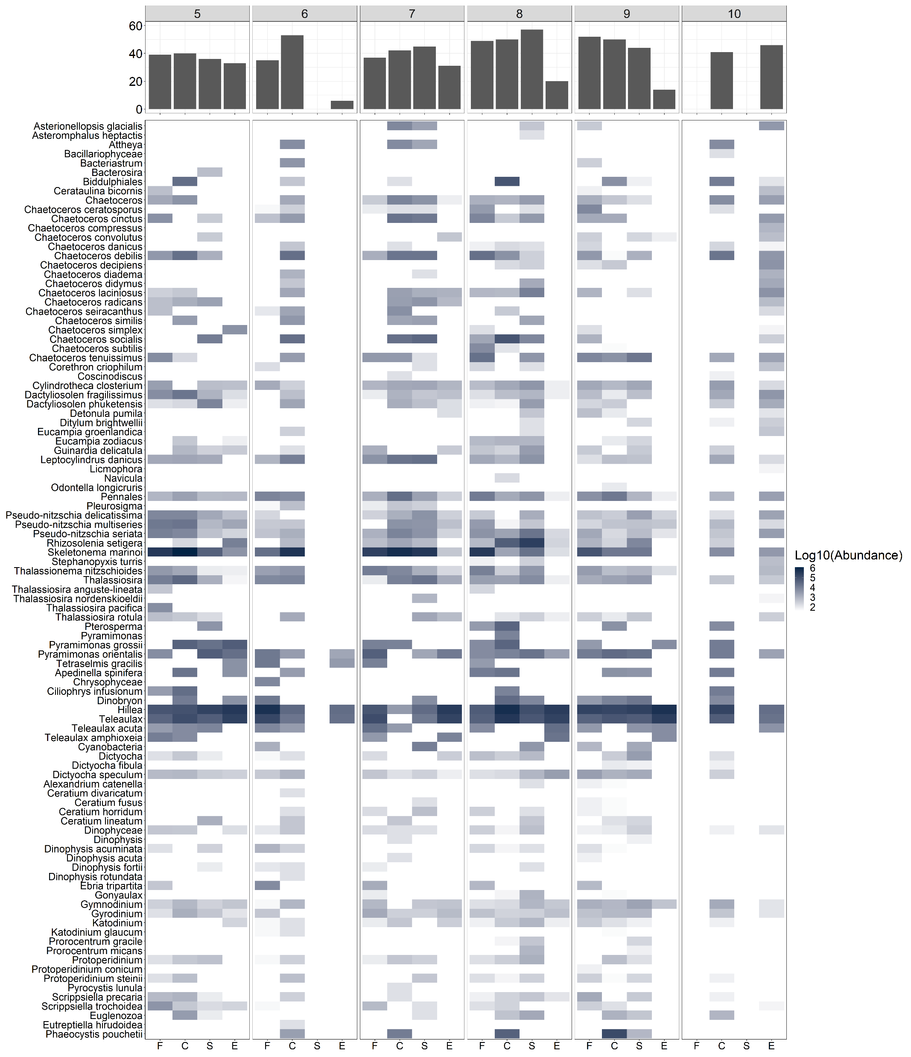
Other plots
2018
richness

Slide 24
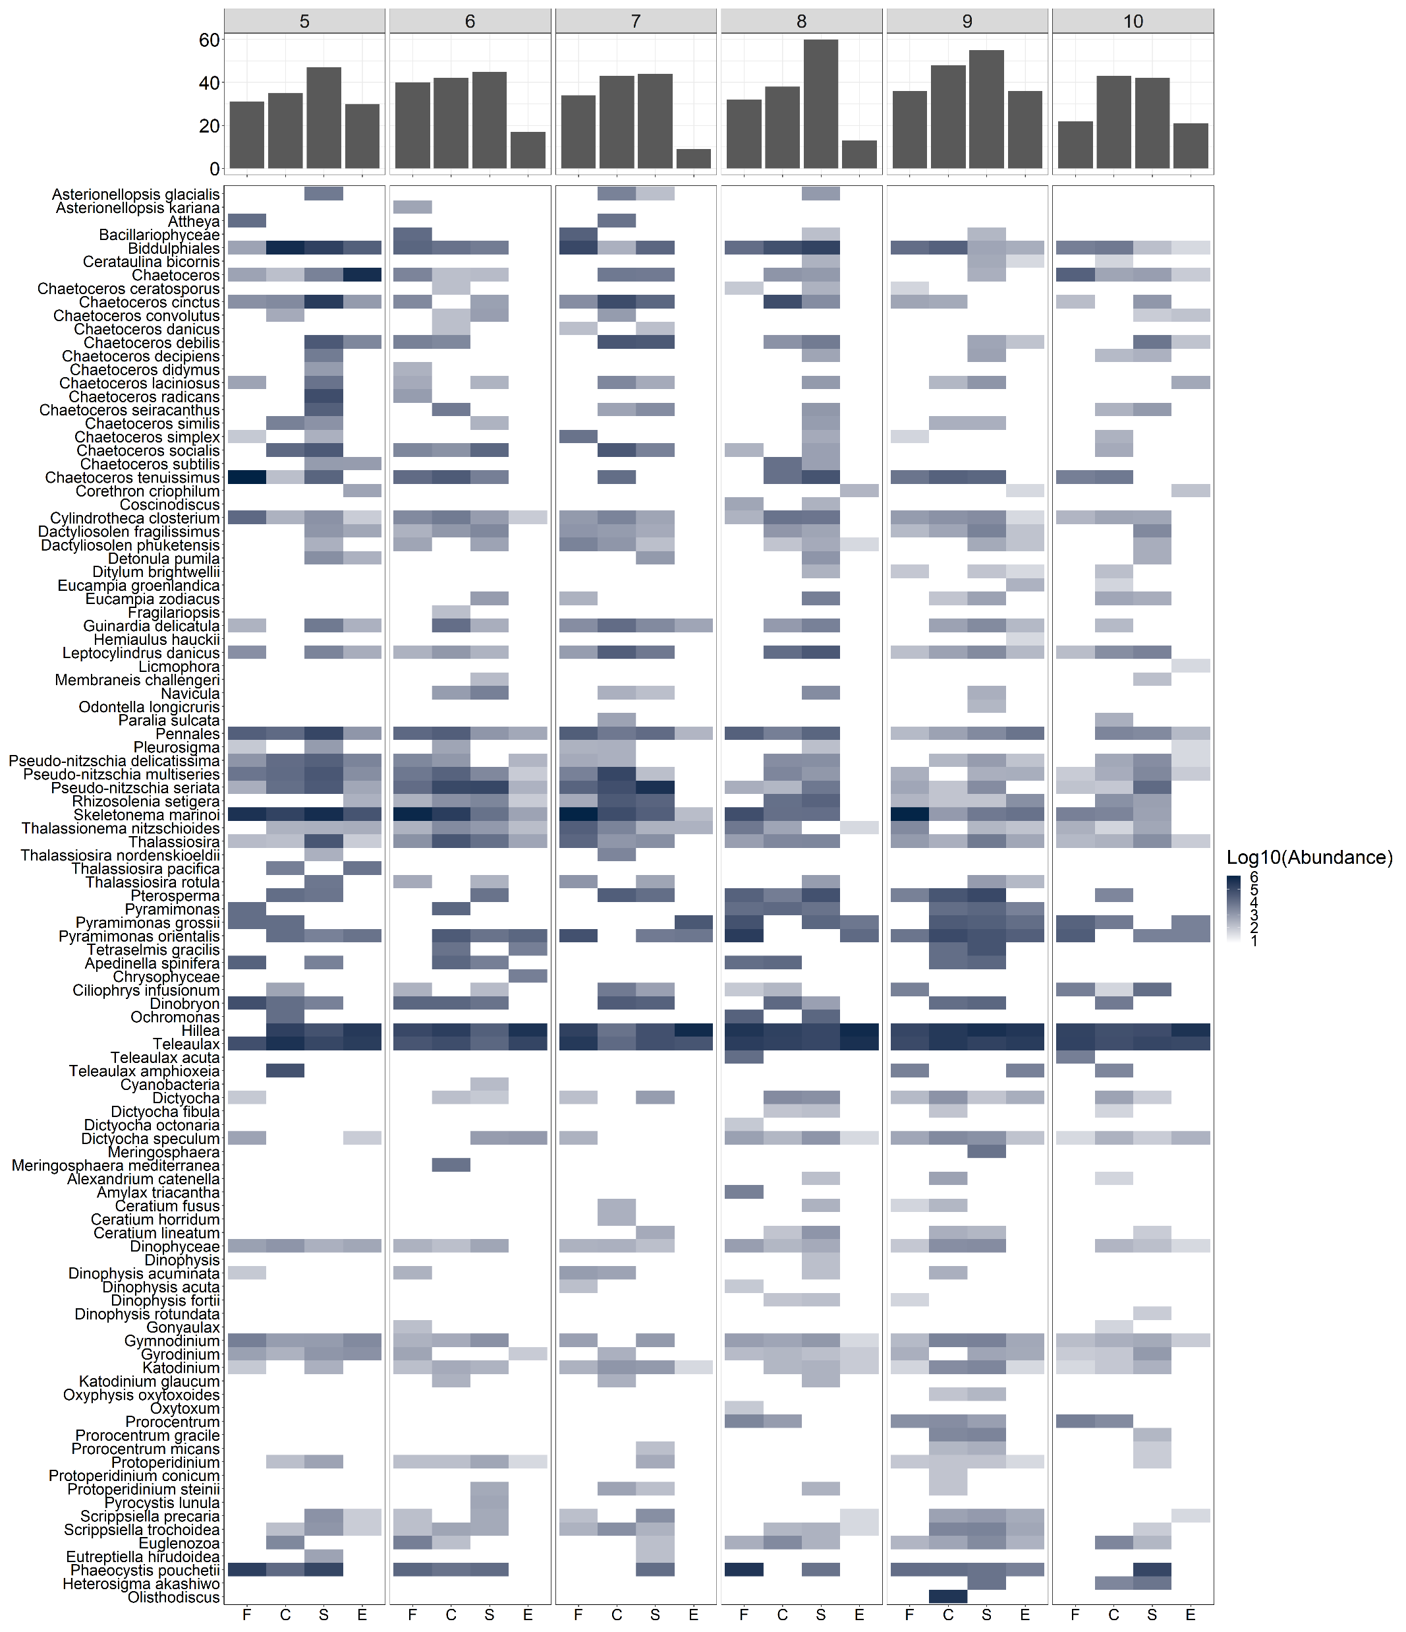
2019

Slide 25
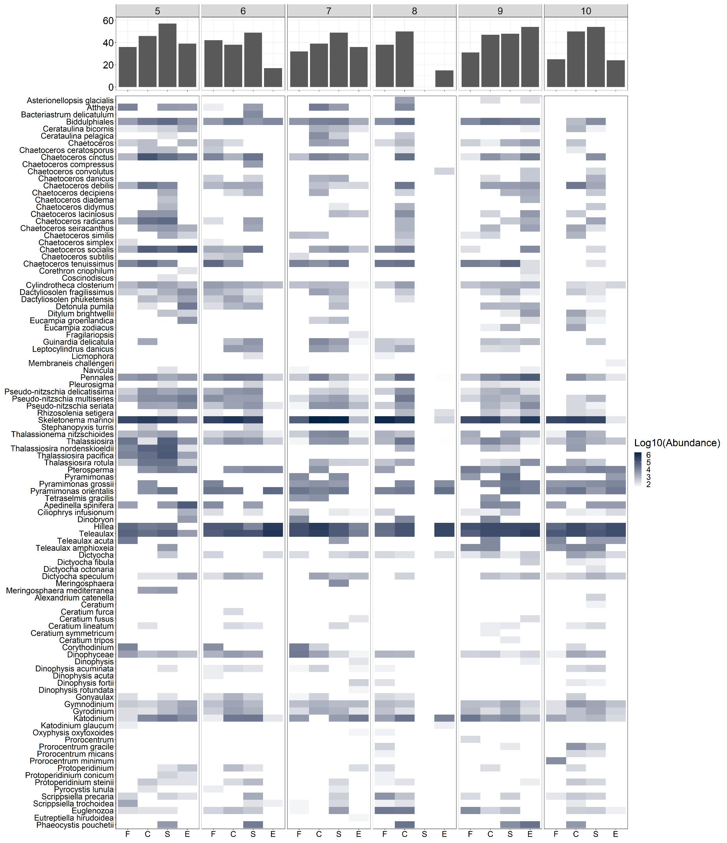
2020

